Slide 1






FUTURE
tense
© Penerbitan Pelangi Sdn. Bhd.

Slide 2





FUTURE
SIMPLE
© Penerbitan Pelangi Sdn. Bhd.

Slide 3








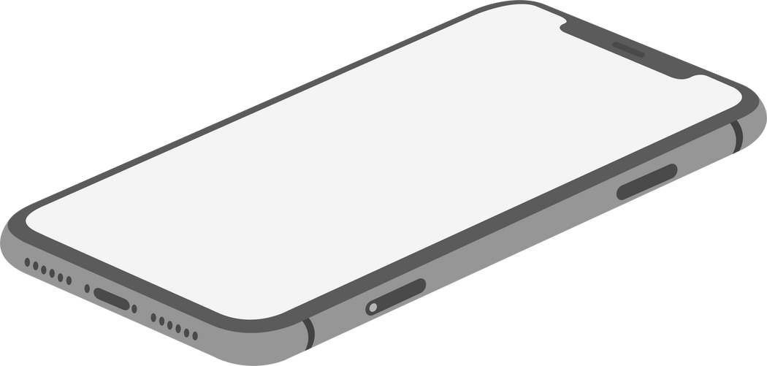
WILL
Positive
Form
Negative
WILL + BASE VERB
WILL NOT + BASE VERB
WON'T + BASE VERB
Functions
• To predict a future event/action.
• For unplanned future actions.
• For future facts.
• For offering, asking for requests, promises,
ordering, warning, threatening.
• For predictions about the future.
Examples:
• I will not be on the flight tomorrow.
• Won't you please go to the meeting at my place tomorrow?
• You won't be doing this again!
• He promised that he won't be late.
• I will take the flight tomorrow morning.
• Will go to the meeting tomorrow?
• If you do not do your homework,
I will confiscate your mobile phone.
• I’m sure he will be back by midnight.
© Penerbitan Pelangi Sdn. Bhd.

Slide 4





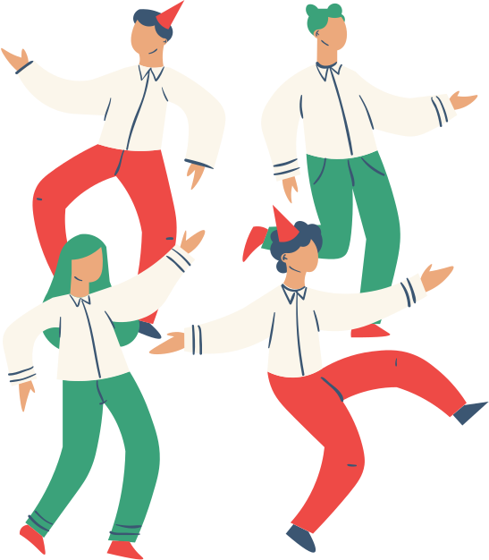





SHALL
Form
SHALL + BASE VERB
Functions
• Used with the affirmative or interrogative form of I
and We when making a suggestion or an offer.
• For future time references with ‘I’ and ‘we’.
Examples:
• Shall we go to the party tonight?
• Shall I make you some tea?
• What shall we do this afternoon?
• I shall never forget this day ever.
© Penerbitan Pelangi Sdn. Bhd.

Slide 5





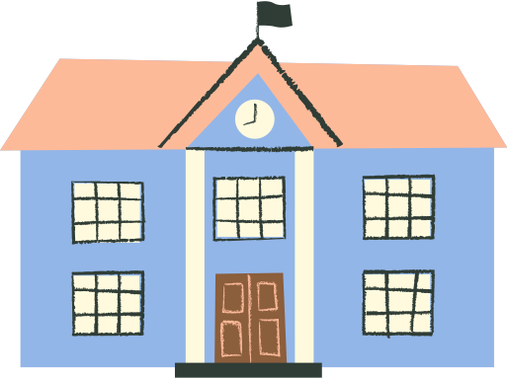
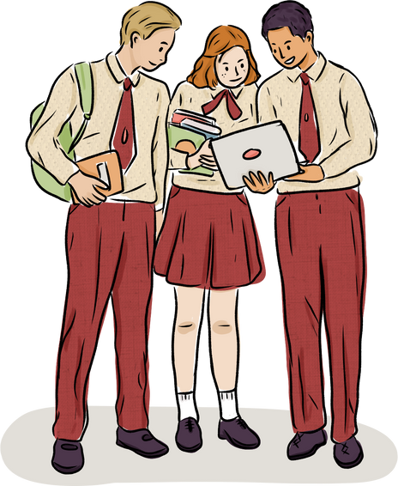

BE GOING TO
Form
SHALL + BASE VERB
Function
• To express a future plan, intentions, and things that we expect to happen in the near future because of something
that is happening in the future.
Examples:
• She is going to pick her son up after work.
• I am going to perform at the festival tomorrow.
• They are going to stay back after school for a study group.
• What are you going to do tomorrow?
© Penerbitan Pelangi Sdn. Bhd.

Slide 6



FUTURE CONTINUOUS
© Penerbitan Pelangi Sdn. Bhd.

Slide 7




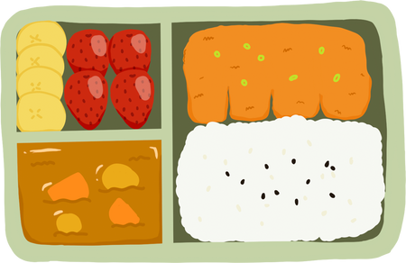
FUTURE
CONTINUOUS
Examples:
• This time next week, we will be having lunch with the mayor!
Form
WILL/WON'T + BE+ [VERB+ING]
• I won't be helping him with his project until he apologised to me.
Functions
• She will be going to the party with me.
• To indicate something that will
occur in the future and continue
for an expected amount of time.
• To tell future plans and arrangements.
• For polite enquiries.
• You will be seeing him at school tomorrow, won’t you?
• Will you be joining us for lunch?
© Penerbitan Pelangi Sdn. Bhd.

Slide 8


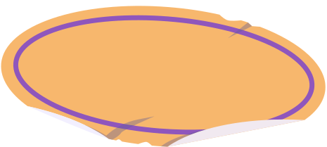

FUTURE PERFECT SIMPLE
© Penerbitan Pelangi Sdn. Bhd.

Slide 9







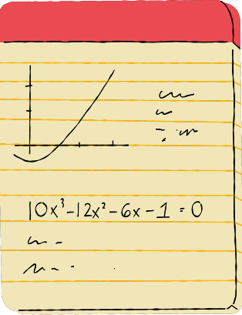

FUTURE Perfect simple
Form
WILL/WON’T + HAVE +
[PAST PARTICIPLE]
Examples:
• You won't have solved the problems by then.
• I will have finished washing the dishes before he gets home.
• A week from now I will have completed my studies.
• Won't she have gone to sleep by the time I get home?
Functions
• To talk about an action that will be
finished by or before a specific time
in the future.
• To show the length of time of an
action at a point in the future
© Penerbitan Pelangi Sdn. Bhd.

Slide 10



FUTURE
PERFECT CONTINUOUS
© Penerbitan Pelangi Sdn. Bhd.

Slide 11





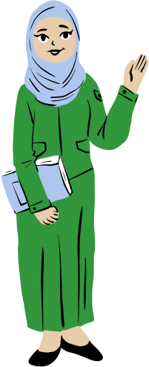
FUTURE Perfect simple
Examples:
• By January 1st, I will have been working here for 8 years.
• The IT department will have been operating for 3 years by then.
• Ms. Haliza will have been teaching
for 20 years by the time she retires in March.
• He will not have been joining the programme before he finishes the job.
Form
WILL/WON’T + HAVE +
BEEN+ [VERB+ING]
Function
• To show an action that will continue
up until a specific time in the future.
© Penerbitan Pelangi Sdn. Bhd.

Slide 12





temporals
© Penerbitan Pelangi Sdn. Bhd.

Slide 13






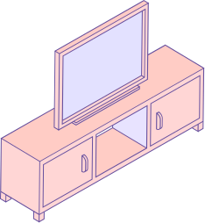
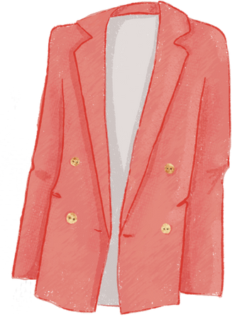

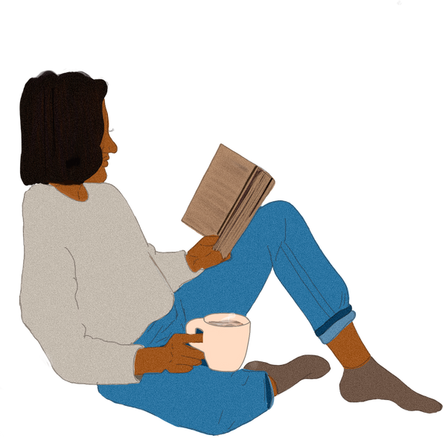
temporals
Functions
when
Examples:
• Time expressions are
used with a present
tense to refer to the
future.
• Used with present
perfect tense to
emphasise that
something will be
finished before
another action.
• She will reply to the text message when she gets home.
before
while
after
• I will clean the table up before I go to bed.
once
until/till
• We will watch the television
after we finish our homework.
by the time
• I will call you as soon as I arrived at the office.
as soon as
the moment
• The parents will wait until the teacher comes in.
• I will put on the coat the moment I hear her coming.
• It will be over by the time we reach there.
• While I am waiting for my friend, I will
read a novel.
• Once it stops raining, I will go out.
© Penerbitan Pelangi Sdn. Bhd.

