Slide 1






Modal
Verbs
Penerbitan Pelangi Sdn. Bhd.

Slide 2




CAN
MAY
WILL
HAVE TO
NEED TO
COULD
MIGHT
WOULD
SHOULD
OUGHT TO
© Penerbitan Pelangi Sdn. Bhd.

Slide 3



FORM:
Modal Verb
+
Base Verb
© Penerbitan Pelangi Sdn. Bhd.

Slide 4


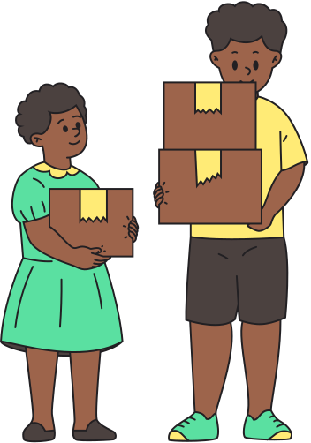

TO TALK ABOUT ABILITY
1
2
CAN/
CANNOT
COULD/
COULD NOT
• I can give the speech. (present)
• She could not speak properly when she was little. (past)
• We can carry the boxes inside today.
• You can lead a horse to water, but you cannot make it drink.
• My grandfather could run like the wind when he was young.
© Penerbitan Pelangi Sdn. Bhd.

Slide 5


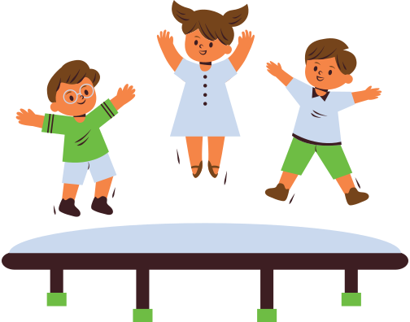
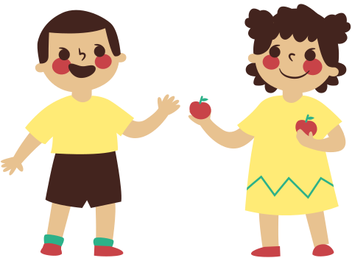
TO ASK OR GIVE PERMISSION
CAN
COULD
MAY
1
2
3
• Can I have this?
• Could I play with you?
• Could I come with you? (more polite)
• You can have it. It’s yours.
• You may not follow me there.
• May I go to the toilet?
© Penerbitan Pelangi Sdn. Bhd.

Slide 6


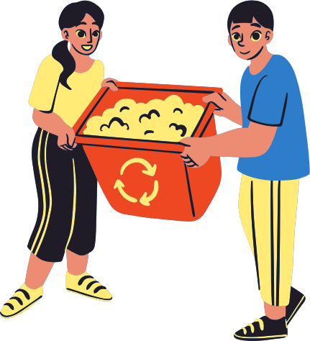

TO OFFER AND REQUEST
CAN
COULD
SHALL
WILL
WOULD
1
2
3
4
5
• Can/Could/Shall I call a taxi for you?
• Can/Will you help me carry this?
• Could/Would you tell me how to get to the bus station? (polite)
• Will you turn the pages for me?
• Could you ask her to leave now?
• Shall I bring this in for you?
© Penerbitan Pelangi Sdn. Bhd.

Slide 7



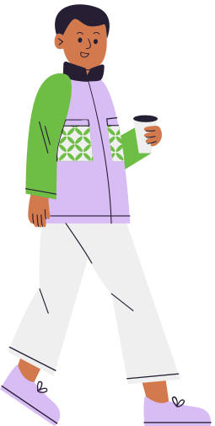

TO SUGGEST
CAN
COULD
SHOULD
1
2
3
• We can/could walk there.
• You should not break the law.
• You could go without me.
• You should bring an umbrella today.
• We can go to the park later.
© Penerbitan Pelangi Sdn. Bhd.

Slide 8


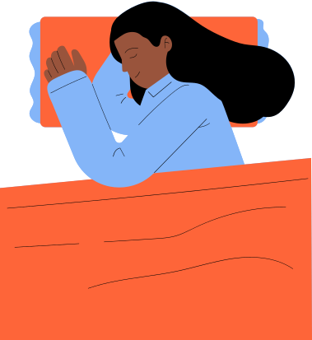

TO EXPRESS OBLIGATION AND NECESSITY
MUST
NEED TO
WILL NEED TO
HAVE TO
1
2
3
4
• You must drive safely.
• You need to follow the rules.
• You will need to come with me. (future obligation)
• You have to/need to wait here for a moment.
• I must study harder.
• I have to do the homework before I go to sleep.
© Penerbitan Pelangi Sdn. Bhd.

Slide 9




TO PROHIBIT
MUST NOT
MAY NOT
CANNOT
1
2
3
• You must not be late for school.
• You must not touch the display in the museum.
• You may not come until you are called.
• You cannot stay here after the bell rings.
• You cannot wear a hat in class.
© Penerbitan Pelangi Sdn. Bhd.

Slide 10



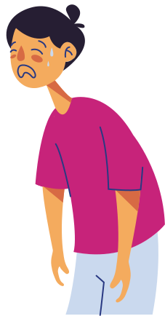
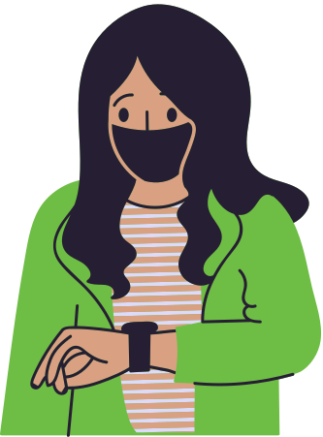

TO EXPRESS POSSIBILITY
MAY
MIGHT
CAN
COULD
1
2
3
4
• This case may/might/could be critical.
• She may/might/could have been here a few minutes ago. (past)
• My mother may/might not remember who you are.
• They could still be waiting for me.
• He could be right.
• The baby could have died if they didn’t
take her to the hospital immediately.
• It can be really hot here in July.
© Penerbitan Pelangi Sdn. Bhd.

Slide 11
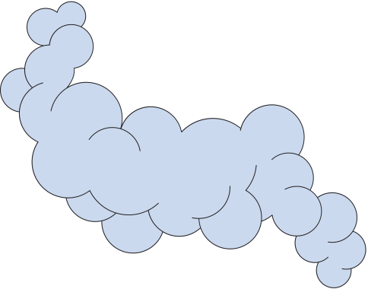

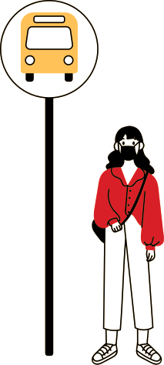

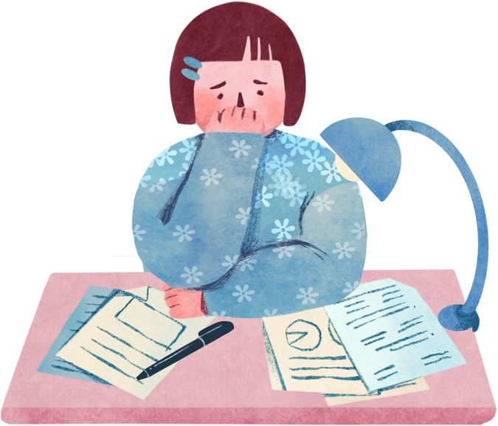
TO DEDUCE AND SPECULATE
COULD
MAY
MIGHT
MUST
1
2
3
4
• The lights are off. He must not be home.
• She is not here. She must have gone home.
• She could be the thief; I don’t know her well.
• I could have finished my work earlier if not for the blackout.
• He might be coming soon.
• I may be in the wrong place and time.
© Penerbitan Pelangi Sdn. Bhd.

Slide 12



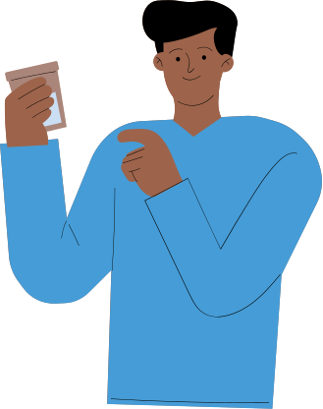
TO GIVE ADVICE AND CRITICISM
SHOULD
OUGHT TO
HAD BETTER
1
2
3
• You should/ought to lock the door.
• You shouldn't/ought not to come home late.
• We had better leave soon or we will be late.
• You should smoke less.
• You had better not forget to do your homework.
• You ought to drink more water.
© Penerbitan Pelangi Sdn. Bhd.

