Slide 1






FIRST
CONDITIONALS
ZERO
CONDITIONALS
CONDITIONALS
SECOND
CONDITIONALS
THIRD
CONDITIONALS

Slide 2

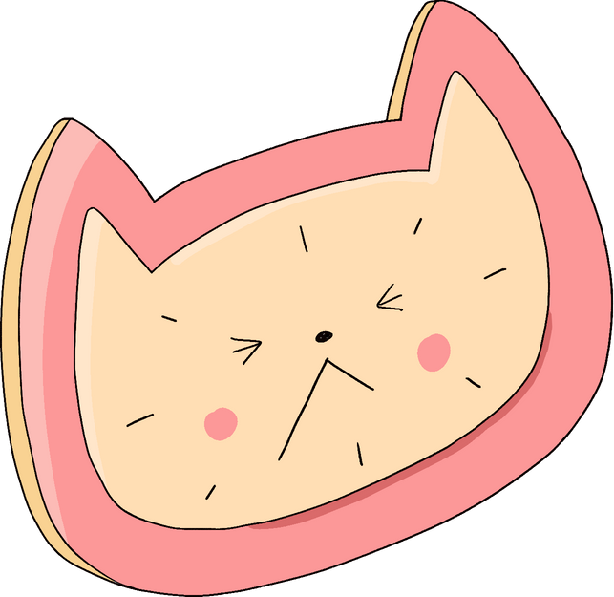




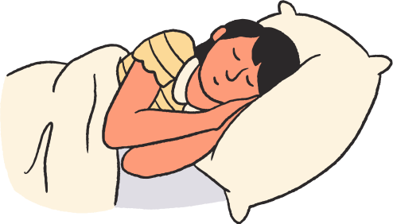

ZERO
CONDITIONALS
If I wake up late,
A. I am late for school.
B. I late for school.
C. I was late for school.

Slide 3
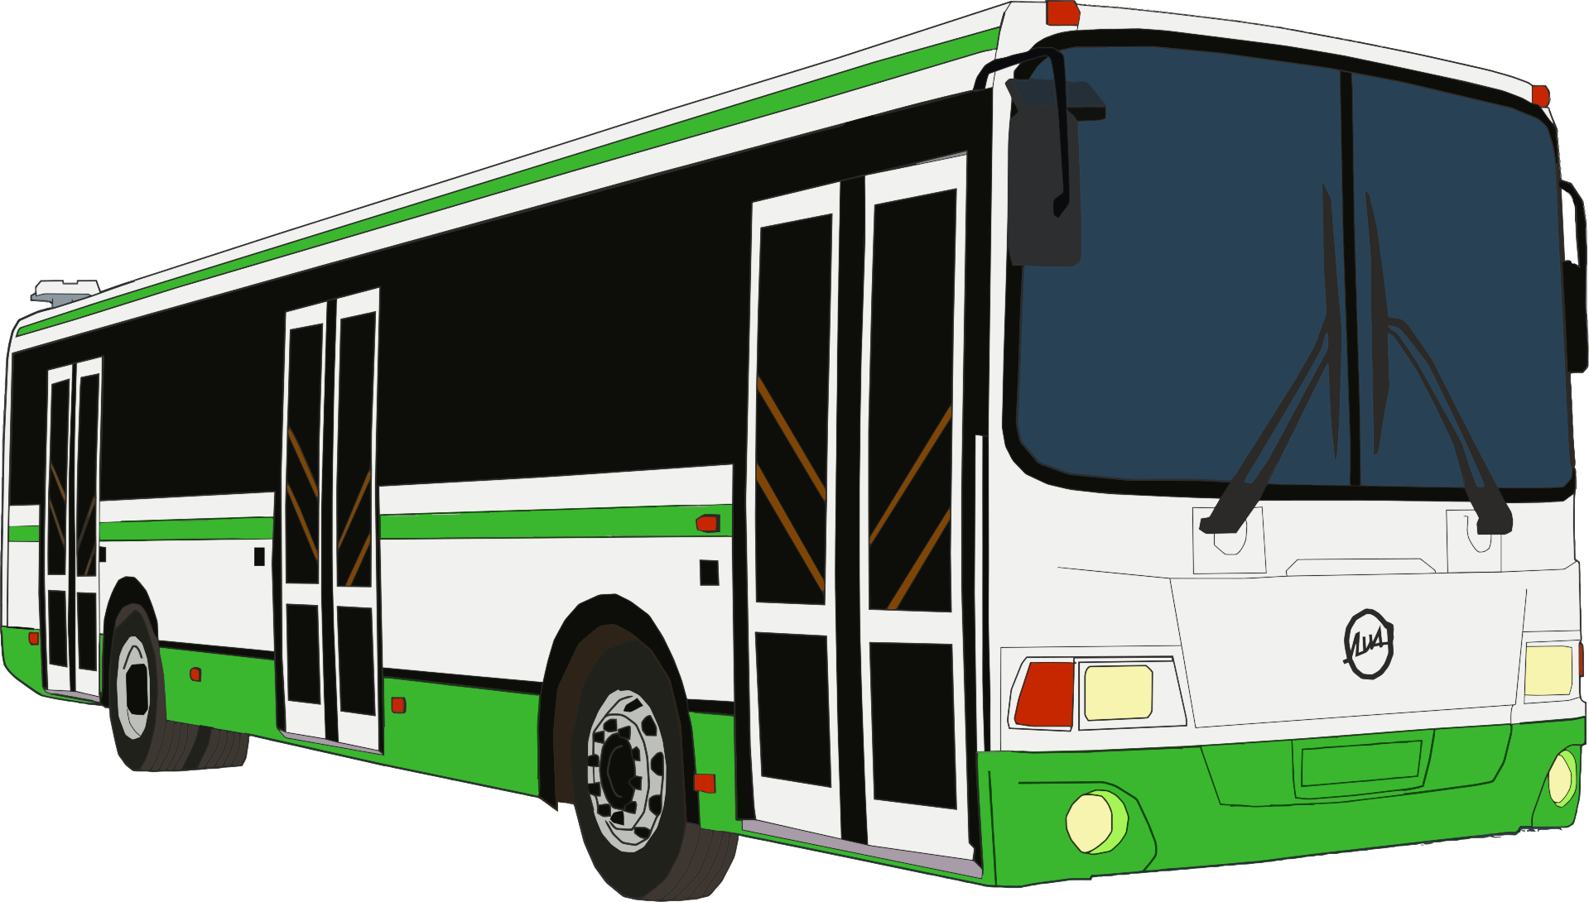


SECOND
CONDITIONALS
If I were the
Prime Minister,
A. I will improve our
transportation system.
B. I would improve our
transportation system.
C. I would have improved
our transportation system.

Slide 4


ZERO
CONDITIONALS
When it is 6p.m.,
A. I got ready to leave work.
B. I always get ready to
leave work.
C. I get ready to leave work.

Slide 5
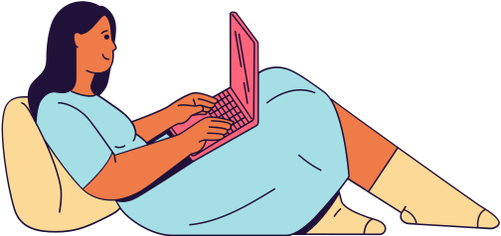

FIRST
CONDITIONALS
If you give me
your email,
A. I would send you the file.
B. I send you the file.
C. I will send you the file.

Slide 6


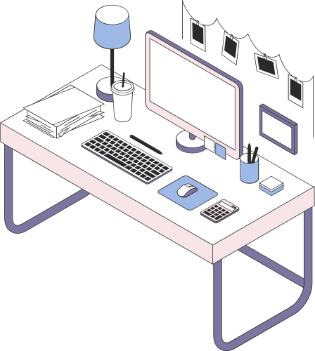
FIRST
CONDITIONALS
If you came
to work yesterday,
A. you will be able
to eat the cake.
B. you would be able
to eat the cake.
C. you would have been
able to eat the cake.

Slide 7
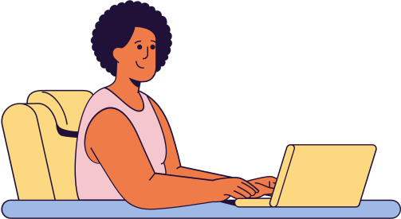

THIRD
CONDITIONALS
If she had finished
her work earlier,
A. she would have been
home by now.
B. she would be home by now.
C. she will be home now.

Slide 8
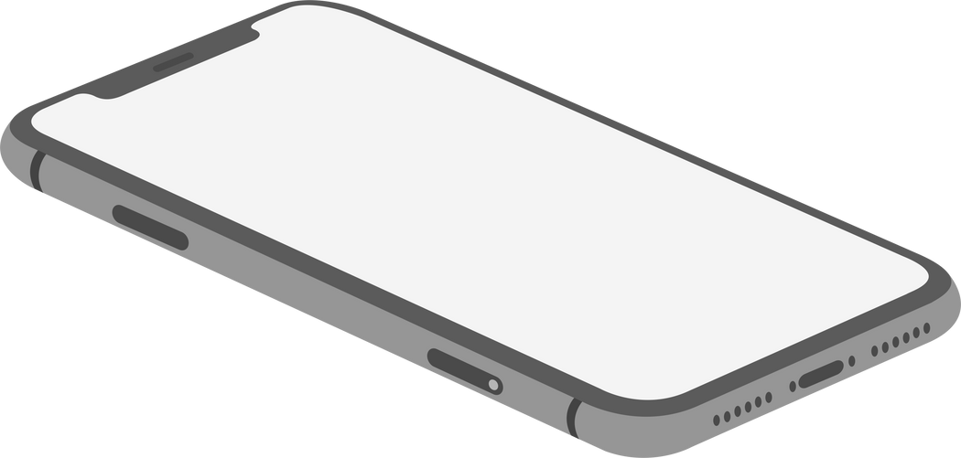
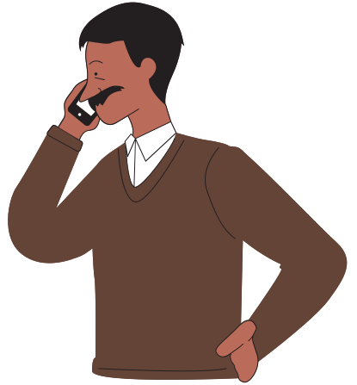
ZERO
CONDITIONALS
If he is there
with you,
A. would you tell him to
give me a call.
B. will you tell him to give me
a call.
C. tell him to give me a call.

Slide 9
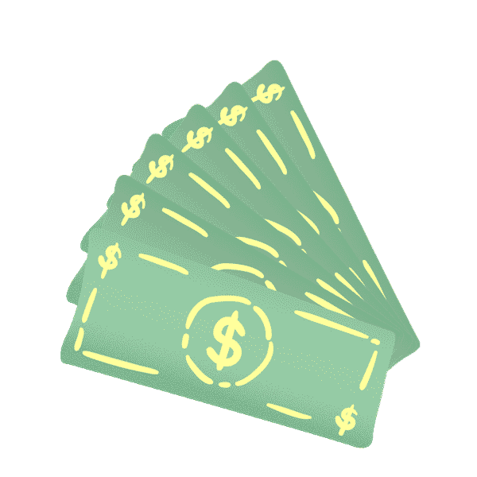
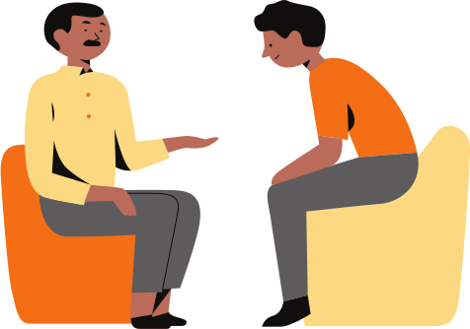
FIRST
CONDITIONALS
If you lend me
some money,
A. I will give it back tomorrow.
B. I would give it back
tomorrow.
C. I give it back tomorrow.

Slide 10
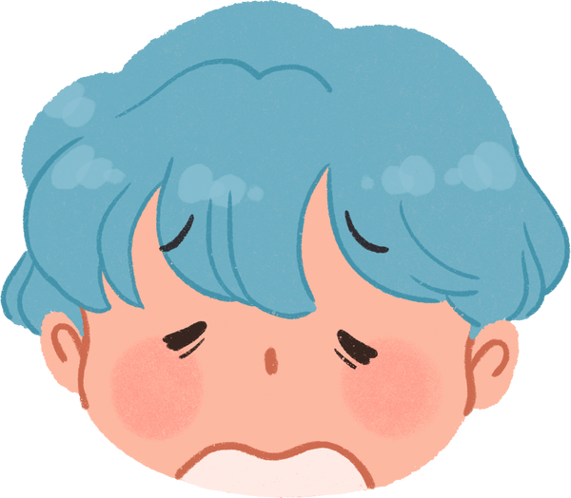
THIRD
CONDITIONALS
If you had told
me earlier,
A. I won't have to
embarrass myself.
B. I wouldn't have
embarrassed myself.
C. I had not embarrass myself.

Slide 11
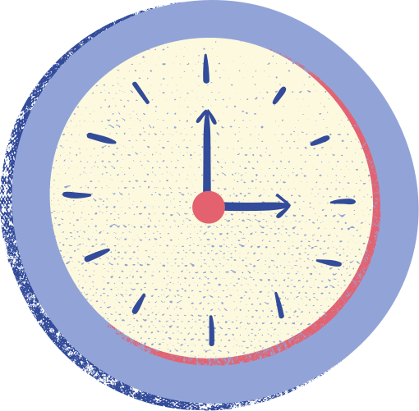


SECOND
CONDITIONALS
If I could turn
back the time,
A. I would have done
things differently.
B. I will have done things
differently.
C. I will do things differently.

Slide 12
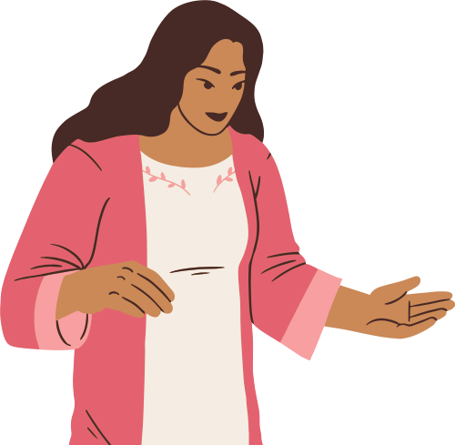
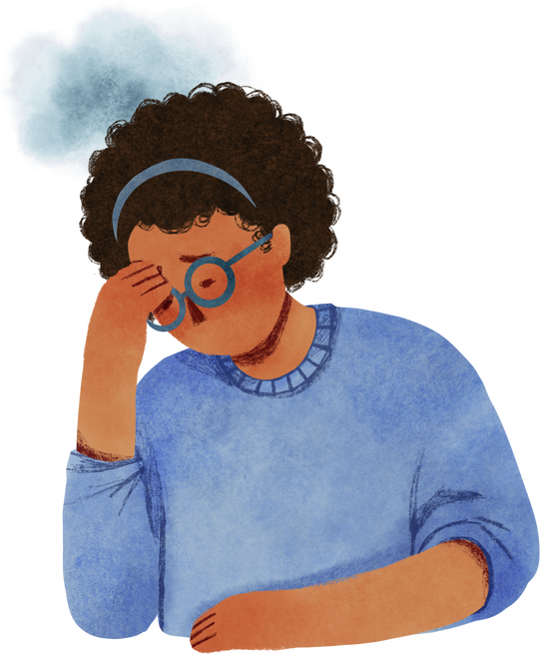
MIXED
CONDITIONALS
If I had listened to
my mother's advice,
A. I will have a better
life now.
B. I would have a better
life now.
C. I have a better life now.

Slide 13
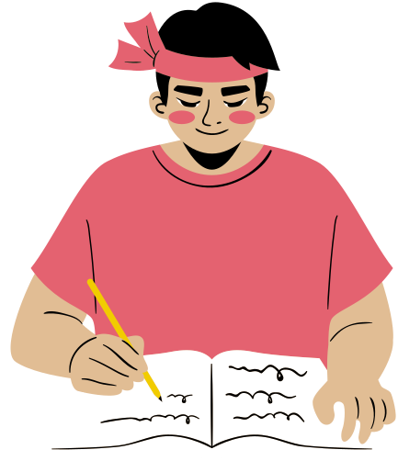
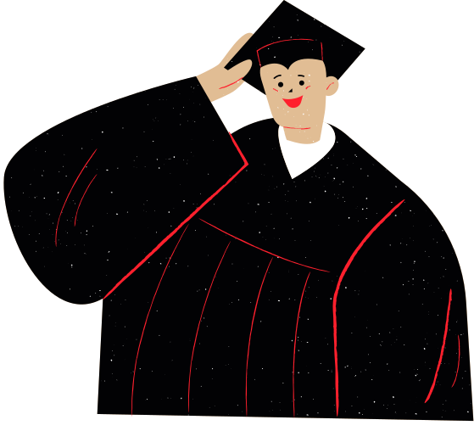
MIXED
CONDITIONALS
If I had studied
harder in the past,
A. I will have gone to
university.
B. I would have gone
to university.
C. I would go to university.

Slide 14
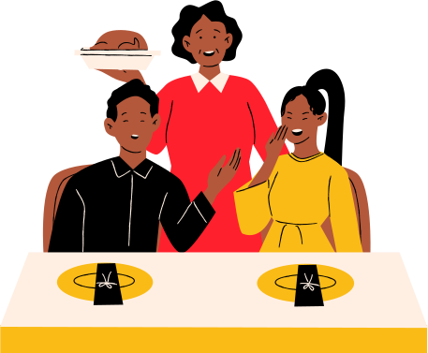
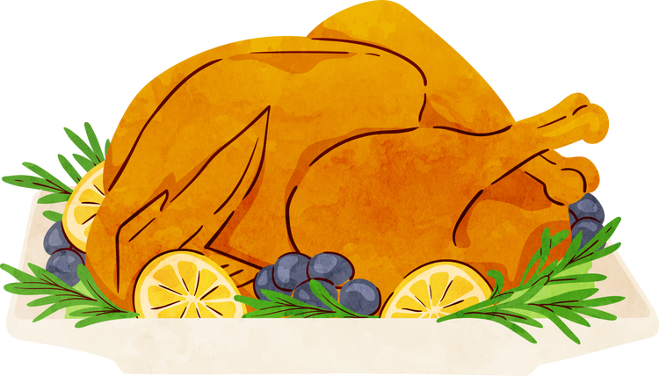
FIRST
CONDITIONALS
When I get paid
by my boss,
A. I would have treated
you a nice dinner.
B. I would treat you to
a nice dinner.
C. I will treat you to a nice
dinner.

Slide 15

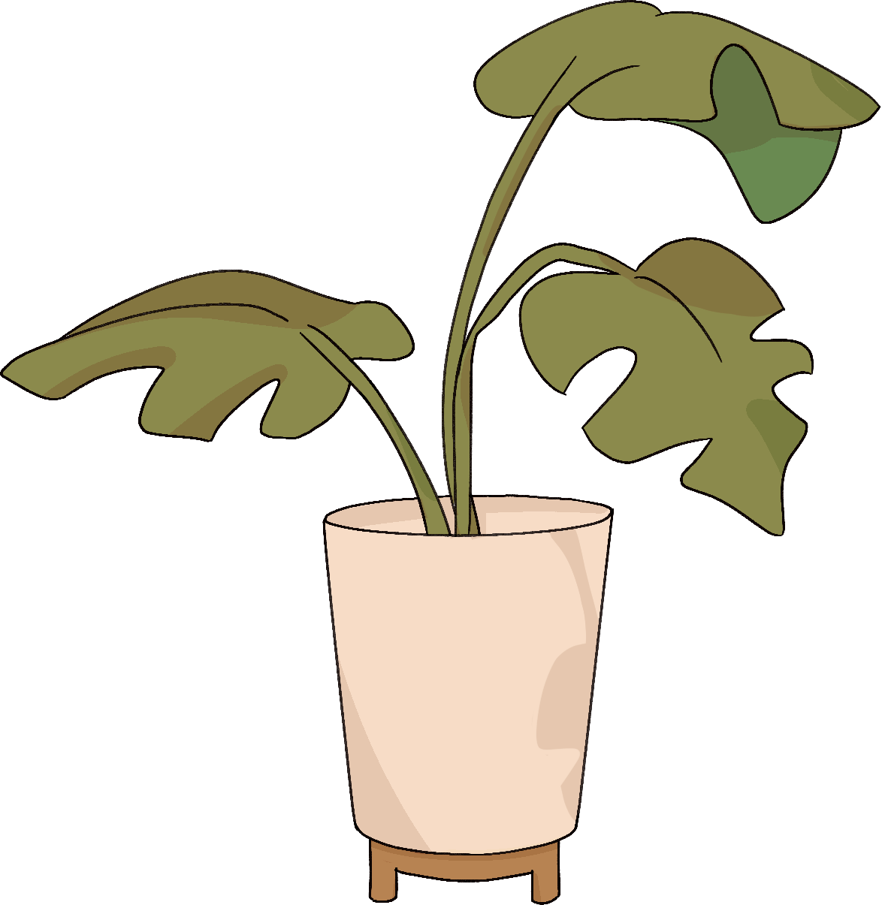

CONGRATULATIONS!
Hope you had fun!

