Slide 1



UNIT 9: GETTING AWAY
Gerunds & Infinitive
Adjectives & Adverbs
© Penerbitan Pelangi Sdn. Bhd.

Slide 2
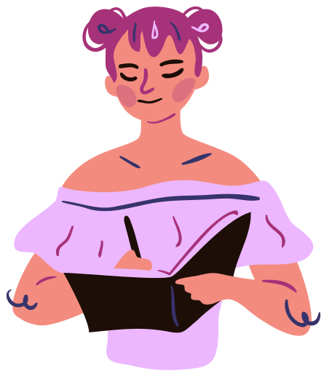



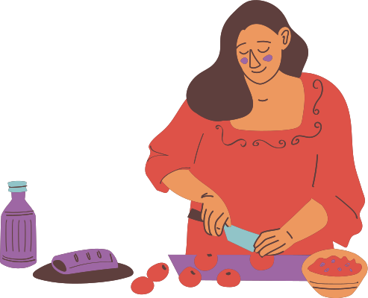
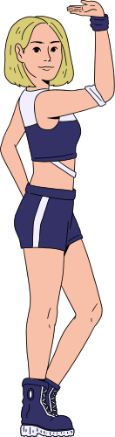
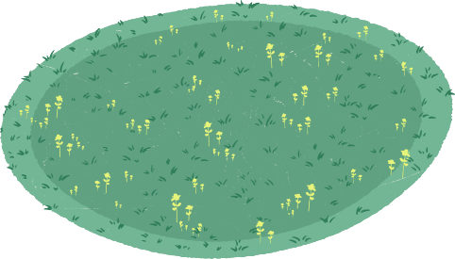
GERUNDS VS INFINITIVE
A VERB FORM THAT ENDS IN ‘ING’
THE BASE FORM OF THE VERB PRECEDED BY ‘TO’
e.g.: walking/eating/dancing/flying
e.g.: to do/to tell/to send/to write
Function as a NOUN
Indicate the purpose of an action
a) Dancing is my hobby.
b) I love walking in the park.
a) I will find the key to open the door.
b) I need to cook dinner by 7 p.m.
© Penerbitan Pelangi Sdn. Bhd.

Slide 3

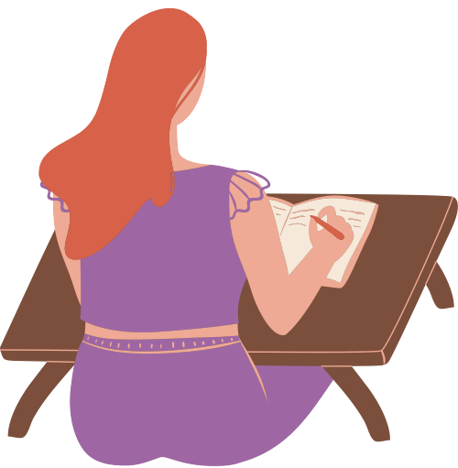
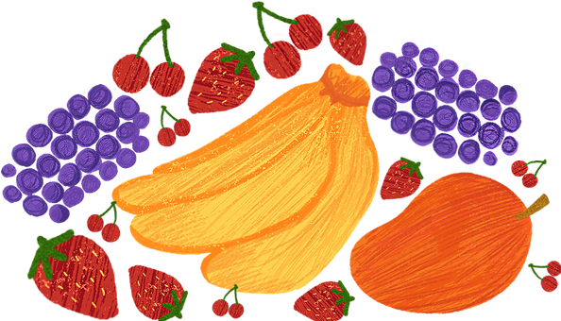
GERUNDS VS INFINITIVE
Used after preposition
As the subject of a sentence
a) Ameer is interested in learning English.
b) Zee is tired of waiting for the right time to go.
a) To change his attitude seems so impossible.
b) To understand each other is the basic rule of a healthy relationship.
Used after some verbs
As the direct object of a sentence
e.g. : enjoy, fancy, discuss, dislike, finish, mind, suggest, recommend, keep, and avoid
a) I like to eat fruits.
b) My niece wants to go to the zoo.
a) I enjoy writing in my journal.
b) Becky stopped smoking a long time ago.
© Penerbitan Pelangi Sdn. Bhd.

Slide 4




COMPARISON OF
ADJECTIVES & ADVERBS
ADJECTIVES – used to modify a noun or pronoun.
The comparative form is used when two things are being compared with each other.
ADVERBS – used to modify verbs or adjectives.
The superlative form is used when more than two things are being compared with one another.
Both adjectives and adverbs can show a degree of comparison.
© Penerbitan Pelangi Sdn. Bhd.

Slide 5
Comparative
Superlative
• Regular forms for one and two syllable words.
words ending in 'er' (taller, shorter, thicker, etc.)
words ending in 'est' (tallest, shortest, thickest, etc.)
• Regular forms for three or more syllable words.
use 'more' (more suitable, more comfortable, etc.)
use 'most' (most suitable, most comfortable, etc.)
Adverbs that end in 'ly' always use 'more' or 'most', such as 'more hardly' or 'most hardly'.
© Penerbitan Pelangi Sdn. Bhd.

